Slide 1
This is Aerospace Medicine
Presented by the
Aerospace Medical Association
1 of 71

Slide 2
Overview
Introduction
Flight Environment
Clinical Aerospace Medicine
Operational Aerospace Medicine
2 of 71

Slide 3
Aerospace Medicine vs. Traditional Medicine
Medical Discipline | Physiology | Environment
Traditional Medicine | Abnormal | Normal
Aerospace Medicine | Normal/Abnormal | Abnormal
3 of 71

Slide 4
Brief History of Flight Medicine
Advent of powered flight presented new physiologic demands such as altitude exposure
Aviation Medicine driven by WWI high losses of life due to physically unfit pilots
Development of manned space flight led to evolution of Aviation Medicine into Aerospace Medicine
4 of 71

Slide 5
Aerospace Medicine Practitioners
Address needs of all who work, recreate, and travel in the air, sea, and space
Trained in medicine, with special knowledge of operating in extreme environments of flight, undersea, and space
Uniquely equipped to make decisions on selection and retention of aviators, divers, and space mission and space flight participants.
5 of 71

Slide 6
Aerospace Medicine Practitioners
Armed Forces across the globe
Aerospace
Medicine
Physicians
Military
FAA/DOT
Space
Agencies
Space
Medical
Operations
Hyperbaric
Medicine
Airline
Medical
Departments
Crew & Passenger Health
Safety Policy
Regulatory Compliance
Certification & Appeals
Aeromedical Examiner training & oversight
Accident Investigation
Evaluation & treatment : pathologic bubble formation
Osteo & soft tissue radionecrosis
Wound Infections
Thermal burns
Astronaut selection & training
Clinical & basic science studies
Development of countermeasures
Longitudinal Health
Support to space agencies & commercial space ventures
6 of 71

Slide 7
Aerospace Medicine Practitioners
Aviation Medical Examiners (AMEs)
Designated, trained, and supervised by the FAA Flight Surgeons
Examine/certify civilian pilots
Training provides an understanding of aviation related problems, physiology, standards, and administrative processes
One week course with mandatory refresher courses
International Aviation Medical Examiners
European Aviation Safety Agency (EASA)
Training provides an understanding of aviation related problems, physiology, standards, and administrative processes
60 hr basic and 60 hr advanced courses
7 of 71

Slide 8
Aerospace Medicine Practitioners
Military Flight Surgeons
Caring for aviators and their families, manage
aerospace medicine and public health programs
Special training programs:
Residency in Aerospace Medicine (RAM)
Non-RAM military courses
8 of 71

Slide 9
Aerospace Medicine Practitioners
National Aeronautics and Space Administration (NASA) Flight Surgeon Duties
Medical care for astronaut corps and their families
Astronaut selection and mission training
Develops physiologic countermeasures for spaceflight
Ensures crew health and safety
Research promoting a better understanding of medical issues associated with spaceflight environment
9 of 71

Slide 10
Advanced Training in Aerospace Medicine
United States
Civilian Residencies
University of Texas - Medical Branch
Wright State University
Civilian Fellowships
Mayo Clinic
Military Residencies
US Navy
US Army
US Air Force
United Kingdom Subspecialty of Occupational Medicine
Civilian Fellowship: King’s College in London
Military Fellowship: Royal Air Force (RAF) Centre of Aviation Medicine
10 of 71

Slide 11
Aerospace Medicine Practitioners (Non-Physicians)
Aerospace Experimental Psychologists
Aerospace Physiologists
Bioenvironmental Engineers
Cognitive Psychologists
Environmental Health Professionals
Flight Nurses
Human Factors Engineers
Industrial Hygienists
Radiation Health Professionals
Systems Engineers
11 of 71

Slide 12
Advanced Training in Aerospace Medicine
Other countries also have advanced training in aerospace medicine with military and civilian components
12 of 71

Slide 13
The Flight Environment
13 of 71

Slide 14
Theory of Flight
Atmospheric flight
Bernoulli and Newton described the concept of lift, when air flows over a wing.
Space Flight
Suborbital and Orbital
Lunar
Interplanetary
14 of 71

Slide 15
The Atmosphere
Composition
Gases
Nitrogen 78 % (at SL 592.8 mmHg)
Oxygen 21%
(at SL 159.6 mmHg)
Other 1%
(at SL 76 mmHg)
Additional Components
Solid particles
Dust
Sea Salt
15 of 71

Slide 16
The Atmosphere
Gaseous mass surrounding Earth which is retained by the Earth’s gravitational field
Governed by gas laws
16 of 71

Slide 17
Key Atmospheric Properties in Ascent
Temperature
Pressure
Humidity
Oxygen
Radiation
17 of 71

Slide 18
The Atmosphere
Pressure:
Units of Measurement
Pressure:
Reference Measurements
International Civil Aviation Organization (ICAO) standard atmosphere
International Atmosphere
US Standard Atmosphere
At sea level, (59°F or 15°C) atmospheric pressure is:
= 760 mmHg
= 29.92 inches Hg
= 1013.2 millibars
At 18,000 ft (5454.5m)
atmospheric pressure is
380 mmHg
18 of 71

Slide 19
Atmospheric Pressure & Altitude
1 atmosphere pressure = 760 mmHg = sea level
¾ atmospheric pressure = 570 mmHg = 8,000 ft (2424 m)
½ atmospheric pressure = 380 mmHg = 18,000 ft (5454.5 m)
¼ atmospheric pressure = 190 mmHg = 33,500 ft (10,151.5 m)
19 of 71

Slide 20
Atmosphere
Biosphere | Characteristic Highlights
Troposphere | Site of the majority of aviation activity Temperature Lapse Rate Temperature Decreases until Tropopause (30,000 ft or 9144 m) at poles & 60,000 ft (18,288 m ) at equator
Stratosphere | Contains Ozone layer, important for UV radiation protection
Mesosphere | Coldest sphere -110 ˚C at 290,000 ft (85 km)
Thermosphere | Charged particles modified by solar flare
Exosphere | Sparse particle collisions Hydrogen & Helium Edge of Space
20 of 71

Slide 21
Aerospace Physiology
Respiration
Cardiovascular System
Spatial Orientation
Bioacoustics
Vision
Sleep and Circadian Rhythms
Acceleration
Gravitational Effects
Vibration
Hypobaria
Hyperbaria
Other Physical Factors
Human Factors
21 of 71

Slide 22
Respiration: Gas Laws
Pressure changes at different altitudes creates various physiologic stresses i.e., hypoxia, decompression
These changes are governed by the Gas Laws such as Boyle’s Law, Dalton’s Law, Henry’s Law
Example: Body cavity volume expansion (GI tract, middle ear, and teeth) with altitude is governed by Boyle’s Law
22 of 71

Slide 23
Respiration
External Respiration
(Ventilation)
Exchange of gases between body and atmosphere
Internal Respiration
Chemical reaction at the cellular level of carbohydrates and oxygen, producing energy as well as carbon dioxide
23 of 71

Slide 24
Respiration: Gas Exchange
Oxygen:
Transported in the body via hemoglobin in the red blood cells and very little in physical solution
Carbon dioxide:
Transport of the waste gas mainly in solution in the blood and 5% via hemoglobin
Gas exchange:
Occurs at the alveolocapillary membrane (oxygen diffuses from alveolus to capillary and combines with hemoglobin, CO₂ diffuses from blood into alveolus and is exhaled)
24 of 71

Slide 25
Respiration
Causes of Hypoxia
Hypoxic Hypoxia
Oxygen deficiency from ineffective gas exchange at lung or inadequate oxygen inspiration
Hypemic Hypoxia
Oxygen deficiency from reduced oxygen carrying capacity in the blood
Histotoxic Hypoxia
Oxygen deficiency from inability to use oxygen at the molecular level
Stagnant Hypoxia
Oxygen deficiency from inadequate delivery of blood flow.
25 of 71

Slide 26
Hypobaria
Altitude (feet/meters) | Effective Performance Time
18,000/6,000 | 20-30 min
25,000/8,333 | 3-5 min
35,000/11,666 | 1 min – 30 secs
50,000/16,666 | 9-12 secs
High Altitude
Low Pressure
Low Partial Pressure O₂
Increased Danger of Hypoxia
Insidious onset makes hypoxia a real danger in high altitude flight.
26 of 71

Slide 27
Hypobaria: Decompression Sickness
Ascent
Decompression
Barometric Pressure (PB)
Decrease
Supersaturation
PN₂ > PB
Pathologic (Nitrogen) Bubble Formation
DCS
Altitude Decompression Sickness (DCS)
Subset of Decompression Illness (DCI)
DCI includes:
Arterial Gas Embolism (AGE)
Ebullism
Trapped gas
Result of decompression in accordance with Henry’s Gas Law
.
Not all bubble formation with decompression leads to DCS.
27 of 71
Notes:
27

Slide 28
Hypobaria: Symptoms of Altitude DCS
Limb pain: at least 70% of all symptoms
Most common presentation
Typically joint or muscle pain
Skin symptoms: about 13% of all symptoms
Mottling, pins & needles, tingling, prickling
Neurologic: about 1-8% of all symptoms
Cold sweat, dizziness, edema, inappropriate or sudden onset of fatigue, headache, light headedness, loss of consciousness, motor and/or sensory loss, nausea, tremor (shakes), vertigo
Pulmonary: about 3% of all symptoms
Cough, dyspnea (difficult or labored breathing), substernal distress (tightness and/or pain in chest, especially during inspiration); sometimes called Chokes
28 of 71

Slide 29
Altitude Hypobaria: Treatment of DCS
Immediate treatment in the aircraft
100% oxygen (until told to stop by qualified physician)
Descend as soon as practical
Declare In-Flight Emergency (IFE)
Land at the nearest airfield with qualified medical assistance available
Symptoms may resolve during descent !
After landing
Hyperbaric Oxygen Therapy (HBOT): compresses bubbles, increasing circulation, and provides more O₂ to tissues
Specialty care for serious DCS symptoms (respiratory or neurologic) or those which do not resolve during descent/repressurization; possible neurologic consult
29 of 71

Slide 30
Hypobaria: Protection from DCS
Adequately pressurized cabin
Denitrogenation by preoxygenation
Pre-Breathing 100% oxygen to “off-gas” nitrogen
Before decompression
Same value, if done below 16,000 ft
30 of 71

Slide 31
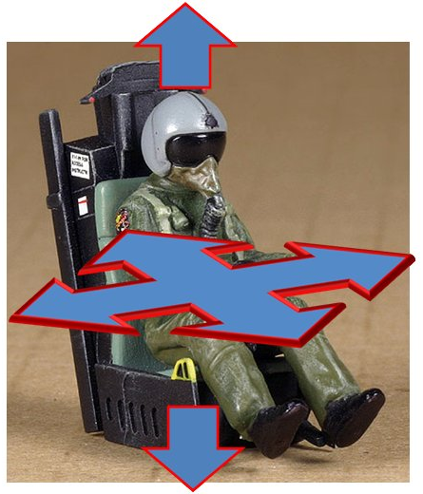
Acceleration, Inertial Forces & Cardiovascular System
CO = MAP/ TPR
Represents the ability of the system to provide adequate blood flow
Accelerative stress challenges the CV system’s ability to maintain blood flow to all vital organs, especially the brain
Accelerative forces may also impede venous blood return to the heart
Goal: Adequate End Organ Perfusion
-G_{z}
+G_{x}
+G_{y}
-G_{y}
-G_{x}
+G_{z}
31 of 71

Slide 32
Acceleration Effects
High Performance Aircraft
G-induced Loss Of Consciousness (G-LOC): state of unconsciousness when the G-forces reduce blood flow to the brain below the critical level
Push Pull Effect: Decreased +G_{z} tolerance resulting from preceding relative -G_{z}
32 of 71

Slide 33
Acceleration
Human Tolerance to +G_{z}
Long duration ( >1 sec)
+ 2 G_{z}
Compression into seat
Movement Difficult
+ 3 G_{z}
Extreme heaviness of limbs and body
Impossible to move or escape from aircraft
Greater than +3 G_{z}
“Dimming” or “ graying” of vision, and possible G-LOC
Short duration (<1 sec)
Up to +40 G_{z} depending on body position
33 of 71

Slide 34
Space Flight Effects
Microgravity affects blood and interstitial fluid flow (approximately 1-2 liters shift towards the head and torso)
Bone demineralization leads to increased loss of calcium in urine and increased risk of kidney stones
Muscle mass reduction
Space motion sickness
Radiation exposure
Decreased immune system function
Psychology/Human factors
34 of 71

Slide 35
Spatial Orientation
Visual (most important), vestibular, somatosensory (seat-of the-pants), and auditory systems
Easily confused when moving in 3 planes of motion (pitch, yaw, and roll)
Disorientation is a leading contributor to many fatal aircraft accidents
35 of 71

Slide 36
Vision
Vision is a key factor for spatial orientation in flight
Errors may occur in visual perception
Color vision deficiencies can affect up to 8% of men and 2% of women.
Identifying these deficiencies is becoming more important as aircraft and air traffic control displays utilize colors and visual cues to display critical information.
36 of 71

Slide 37
Bioacoustics
Noise in aviation can be detrimental to hearing & communication
dBA | Sound
20 | Whisper at 5 ft.
50-70 | Normal Conversation
100-110 | Power Lawn Mower
130 | Pain Threshold for Humans
140-160 | Jet Engine
167 | Saturn V Rocket
37 of 71

Slide 38
Vibration
Vibration is oscillatory motion in dynamic systems
Human body most sensitive to vibration in vertical direction
Vibration affects a variety of body systems
General discomfort at 4.5-9 cycles per second (cps)
Abdominal pain at 4.5-10 cps
Lumbosacral pain at 8-12 cps
Head sensations at 13-20 cps
38 of 71

Slide 39
Other Physical Factors Associated with Flying
Thermal
Extreme temperature swings in aviation (e.g. hot in cockpit on tarmac & freezing cold at altitude)
Radiation
Air travel at high altitudes
Risk for commercial aviation and spaceflight crews
Toxicology
Importance of knowledge of toxins in aviation (jet fuels, release of toxic fumes in fires, alcohol in blood versus vitreous, etc.)
39 of 71

Slide 40
Human Factors
By definition, Human Factors is the impact of human behavior, abilities, limitations, and other characteristics to the design of tools, machines, systems, tasks, jobs, and environments for productive, safe, comfortable, and effective human use.
The goal of Human Factors is to apply knowledge in designing systems that work, accommodating the limits of human performance.
40 of 71

Slide 41
Human Factors
Human-Machine Interface
Human Error implicated in 60-80% of accidents in complex, high technology systems
Task and information overload is critical issue
Science of color, size, position of switches/knobs, etc. and relevance to mission drive design
41 of 71

Slide 42
Human Factors
Sleep & Circadian Rhythms
Internal body clock shifts with travel and work schedule and may impairs performance
Need to plan crew work-rest cycles to avoid accidents
42 of 71

Slide 43
Life Support Systems
Oxygen Systems
Dilutor Demand
Flow of oxygen proportional to cabin altitude [100% oxygen at 33,000 ft (10,058 m)]
Pressure Demand
Oxygen supplied with slight overpressure > 10,000 ft to full pressure breathing
> 38,000 ft (11,582 m)
UK: >40,000 ft (12,192 m)
Pressure Demand with Regulator
Mounted on panel, seat or mask
Regulator attached to mask directly or via hose
Continuous Flow
Passenger system, exhaled air collected in bag to economize oxygen use
May be chemically generated for short term emergency use
43 of 71

Slide 44
Cabin Air Quality
Cabin Air Quality Factors
Pressure
Oxygen
Carbon Dioxide
Temperature
Ozone
Humidity
Bioaerosols
Tobacco
44 of 71

Slide 45
Cabin Air Quality
Relative Humidity
At altitude in cabin ~ 6-10%, flight deck ~ 3%
Due to very dry ambient air at altitude
Air conditioned air entering AC cabin has relative humidity < 1%
Irritation of eyes / sense of dry mucous membranes
Plasma osmolality maintained by homeostatic renal function
Air Recirculation
Complete air exchange every 3-4 min (homes q 12 min)
Up to 30-50%
High efficiency particulate air filter filtration (efficient to 0.3 micrometers)
Carbon Dioxide
0.5 % by volume (sea level equivalent)
45 of 71

Slide 46
Life Support Systems
Airline Medical Systems
Minimize risks to passengers
Avoid unscheduled diversions
Onboard emergency medical capabilities are limited (airline medical kits)
Communication with ground support from internal airline medical staff or contracted staff
Passengers requiring medical oxygen must make separate arrangements with the airline
Cockpit emergency oxygen is via a compressed oxygen system and is separate from passenger emergency oxygen
Emergency oxygen: 10-20 minute supply for passengers produced with chemical oxygen generators
Limited number of walk-around bottles for crew
46 of 71

Slide 47
Clinical Aerospace Medicine
47 of 71

Slide 48
Fitness for Duty & Return to Flight Status
Screen aviators, astronauts, air traffic control personnel for risk of sudden incapacitation or degradation in skills
Applies to all areas of medicine
Applies to all types of aviators, i.e. military, commercial pilots, private pilots, and flight crew
48 of 71

Slide 49
Fitness for Duty & Return to Flight Status
Medical Standards
Civilian standards (i.e. FAA, NASA, EASA) and military standards (Air Force, Navy, Army) may differ due to different aircraft, mission requirements, and operating environments. Examples include:
Type of aircraft - Multi-crew Aircraft vs. Single Seat Fighter Jet
Type of Operation/Environment
Recreational vs. Airline Transport Operations
Wartime, Remote environments
Initial selection vs. Maintenance of Standard
49 of 71

Slide 50
Fitness for Duty & Return to Flight Status: Multisystem Approach
Cardiology
Pulmonology
Ophthalmology
Otolaryngology
Psychiatry and Psychology
Neurology
Other Conditions
50 of 71

Slide 51
Fitness for Duty & Return to Flight Status
Cardiology
Assessment important to mitigate risk of sudden/ subtle incapacitation in aviation and space travel
Arrhythmias
Coronary disease
Valvular disease
Syncope
Pacemakers
51 of 71

Slide 52
Fitness for Duty & Return to Flight Status
Pulmonology
Trapped gas (like bullae, for example) increase risk of barotrauma with changes in pressure
Lung disease leading to hypoxia under hypobaric conditions may increase need for oxygen in flight and impact safety
Sleep apnea and resulting fatigue can impact aviation safety
52 of 71

Slide 53
Fitness for Duty & Return to Flight Status
Ophthalmology
Importance of Vision in Aviation
Distant, Intermediate & Near Vision
Target acquisition (less important with modern weapons)
Ability to safely operate the aircraft
See and be seen in visual flight rules (VFR)
Color Vision
Instrument displays
Depth perception and stereopsis
Terrain avoidance
Landing
Maintenance of visual acuity
Refractive surgery
Refractive correction with glasses /contact lenses
53 of 71

Slide 54
Fitness for Duty & Return to Flight Status
Otolaryngology: Key Issues
Hearing and hearing protection
Vestibular system
Barotrauma due to trapped gas in sinus and ear cavities
54 of 71

Slide 55
Fitness for Duty & Return to Flight Status
Psychology & Psychiatry
The absence of significant psychiatric disease, including psychosis and personality disorders, is an important prerequisite to safe operation of aerospace systems
Psychological and psychiatric factors important with long term isolation and in small groups (multi-crew aircraft)
Long-duration spaceflight
Exploration, Orbital
Commercial aircraft - locked cockpit door
Commercial Spaceflight/Spaceflight participants
55 of 71

Slide 56
Fitness for Duty & Return to Flight Status
Neurology
Neurological evaluations for flight fitness optimize safety and performance by focusing upon conditions with the potential to lead to sudden/subtle incapacitation
Seizures
TIA & Stroke
Traumatic Brain Injury
Unexplained Loss of Consciousness
Intracranial Masses & Cancers
HIV & AIDS
Sleep Disorders
Disqualifying Medications
56 of 71

Slide 57
Fitness for Duty & Return to Flight Status
Other Medical & Surgical Conditions
Evaluation of any condition or treatment that may potentially:
Impact flight safety
Influence crew performance in flight
Influence behavior or cognitive processing
Lead to sudden/subtle incapacitation
Aerospace Practitioners Continuously Review Changing Medical Practices, Procedures, and Medications for Use in the Flight & Space Environments
57 of 71

Slide 58
Fitness for Duty & Return to Flight Status
Health Maintenance of Aircrew
Well-being: Interaction between physical, psychological and emotional factors
Importance of regular crew rest cycles
Importance of exercise and diet
Importance of avoidance of self induced stressors, i.e., alcohol, nicotine, caffeine
Importance of maintaining balance on life
Work/family life
58 of 71

Slide 59
Fitness for Duty & Return to Flight Status
Longitudinal Health & Wellness Surveillance
Ensure aircrew have long, safe, and productive careers
Measure and evaluate emerging occupational risks/exposures or environmental threats
59 of 71

Slide 60
Clinical Hyperbaric Medicine
Hyperbaric Oxygen Therapy (HBOT) addresses pathologic bubble formation most frequently encountered in flying diving and space operations activities, selected infections, wounds and traumatic injuries.
Recent investigations have provided a better understanding of basic science mechanisms underlying Undersea & Hyperbaric Medicine Society approved clinical indications
Training options : Comprehensive Hyperbaric Medicine Fellowship (1 yr.) , board certification and courses
Indications for HBOT
Decompression Sickness
Air Gas Embolism
CO/CN Poisoning
Compromised Flaps & Grafts
Crush Injury
Exceptional Blood Loss Anemia
Thermal Burns
Intracranial Abscess
Necrotizing Soft Tissue Infection
Refractory Osteomyelitis
Delayed Radiation Injury (Osteoradionecrosis & Soft Tissue Radionecrosis)
Central Retinal Artery Occlusion
60 of 71

Slide 61
Operational Aerospace Medicine
61 of 71

Slide 62
Operational Aerospace Medicine
Address challenges of operating aerospace vehicles in a physiologically challenging environment
Conducted in military and civilian setting
Management and prevention of medical events during operations
62 of 71

Slide 63
Operational Aerospace Medicine
Issues in civilian operations
Commercial air transport flight operations
Deep vein thrombosis prophylaxis in susceptible individuals,
Circadian rhythm issues
Potential for spread of infectious diseases
Consideration of radiation exposure
Commercial spaceflight operations
63 of 71
Notes:
Civilian operations
Commercial air transport flight operations for passengers and cargo can be lengthy and therefore necessitates medical prevention strategies such as:
deep vein thrombosis prophylaxis in susceptible individuals,
circadian rhythm issues
potential for spread of infectious diseases
consideration of radiation exposure
Emerging commercial spaceflight operations underlie the importance of continued judicious review and assessment for medical standards based operations.

Slide 64
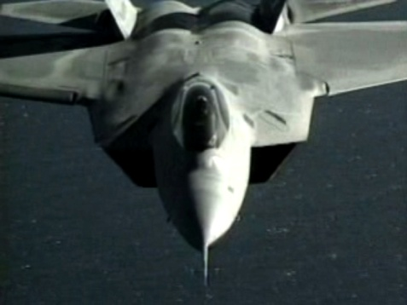
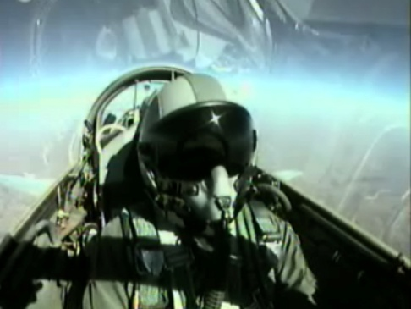
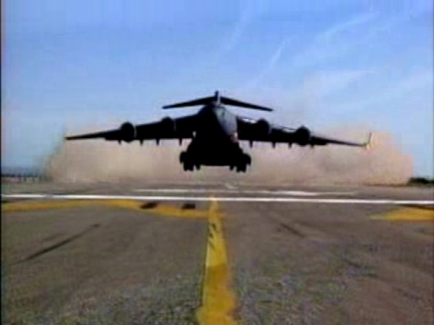
Operational Aerospace Medicine
Military crew members can be required to operate at very high altitudes for the purposes of reconnaissance, combat, or routine training operations
The unique stresses of extreme altitude operations require special protective equipment and training
Photographs courtesy of the Federal Aviation Administration
64 of 71

Slide 65
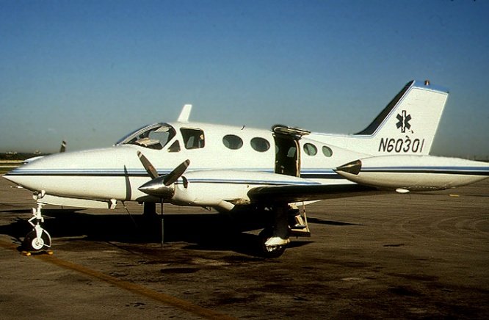
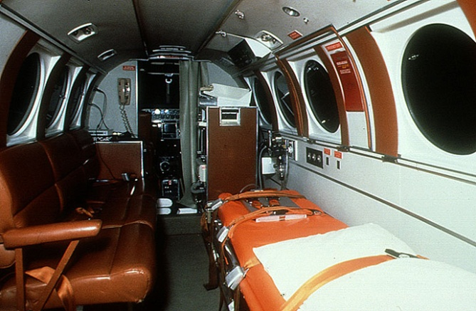
Operational Aerospace Medicine
Aeromedical Transportation encompasses the transport and inflight care of patients of different acuity levels.
Noise, vibration, communication, pressure changes and combat activities can impact ability to deliver care in these settings.
These transports include fixed-wing aircraft and rotary wing aircraft.
Photographs courtesy of the Federal Aviation Administration
65 of 71

Slide 66
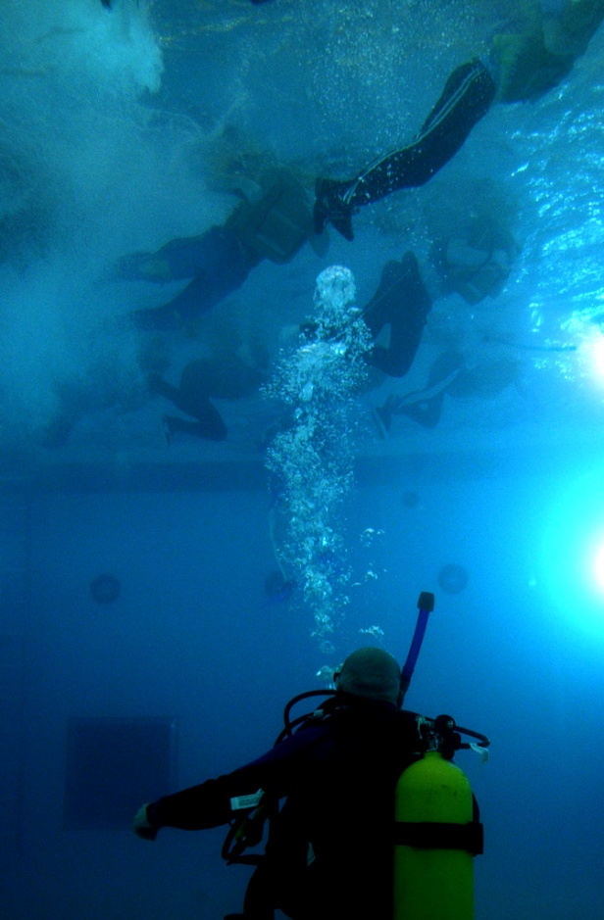
Operational Aerospace Medicine
Hyperbaric Medicine Practitioners support a variety of occupational, training, and remote diving activities
Oil Industry
Astronaut Dive Training for Extravehicular Activities
Underwater Search & Rescue Support
Photograph courtesy of the Federal Aviation Administration
66 of 71

Slide 67
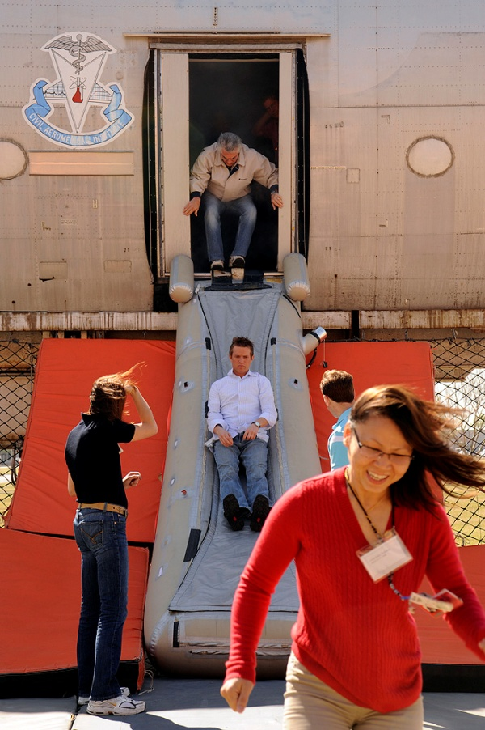
Survival, Search & Rescue
Crash Worthiness – Primary/Secondary Protection
The aircraft and its systems are a life support system and its thoughtful design may greatly aid in the survivability of a crash
Search & Rescue Systems
Beacons
Increased use of satellite technology
Organized systems in civilian environment and military
Importance of survival training
Photograph courtesy of the Federal Aviation Administration
67 of 71

Slide 68
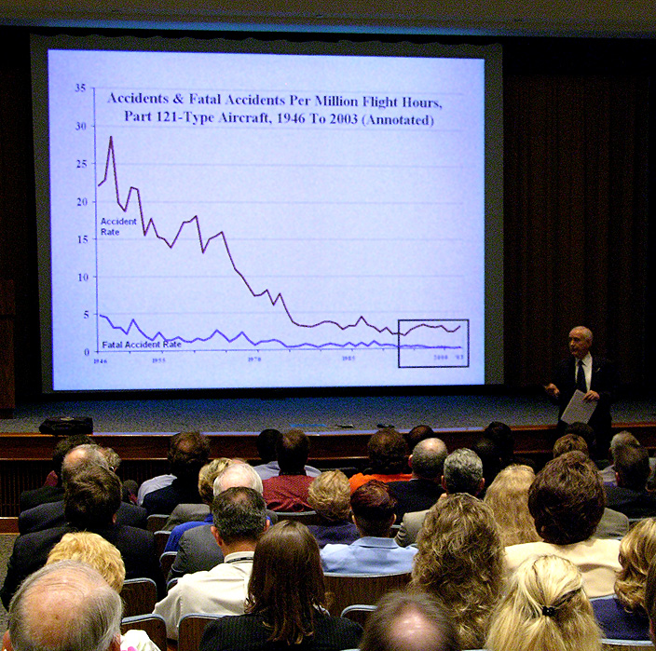
Accident Investigation
Significant improvements in accident rate and data since the 1960s due to:
Improved operational procedures
Technological developments
Application of lessons learned from accident investigations
Photograph courtesy of the Federal Aviation Administration
68 of 71

Slide 69
Accident Investigation
Methodical & multidisciplinary evaluation of aspects that may have contributed to an accident
Civilians and Military use similar resources
Flight Surgeons
Emergency Response Teams
Hazardous Materials Specialists
Aviation Experts
Airframe Maintenance & Engineering Experts
Air Traffic & Air Field Experts
Pathologists & Toxicologists
Dentists
Coroners
Law Enforcement Officers
69 of 71

Slide 70
Accident Investigation
Accident Summary
Nature of Accident
Communication with ATC
Flight Data Recorder
Witness Reports
Weather Conditions
Pilot Information
Certification & Class
Age & Health History
Historical Flight Performance
Assigned AME
Aircraft Certification
Type of Aircraft
Vehicle Maintenance Information
On Scene Investigation
Fire, Blast, Acceleration Evidence
Grid Debris and Victims
Mechanism of Injury
Photography
X-Rays
Toxicology
Body Fluids & Tissues of Key Crew Evaluated
Forensics
Forensic Dentistry
DNA
Corroboration with Archival Accident Data
70 of 71

Slide 71
Acknowledgements
Anthony Artino PhD
Professor Michael Bagshaw
Eilis Boudreau MD PhD
Yvette DeBois MD MPH
Marvin Jackson MD
Jeff Myers MD
David Rhodes MD MPH
Philip Scarpa MD
Erich Schroeder MD MPH
Greg Shaskan MD
Jan Stepanek MD MPH
Jeffrey Sventek MS
James Webb PhD
71 of 71

