Slide 1
What is Aerospace Medicine?
The Aerospace Medicine Association, 2018

Slide 2
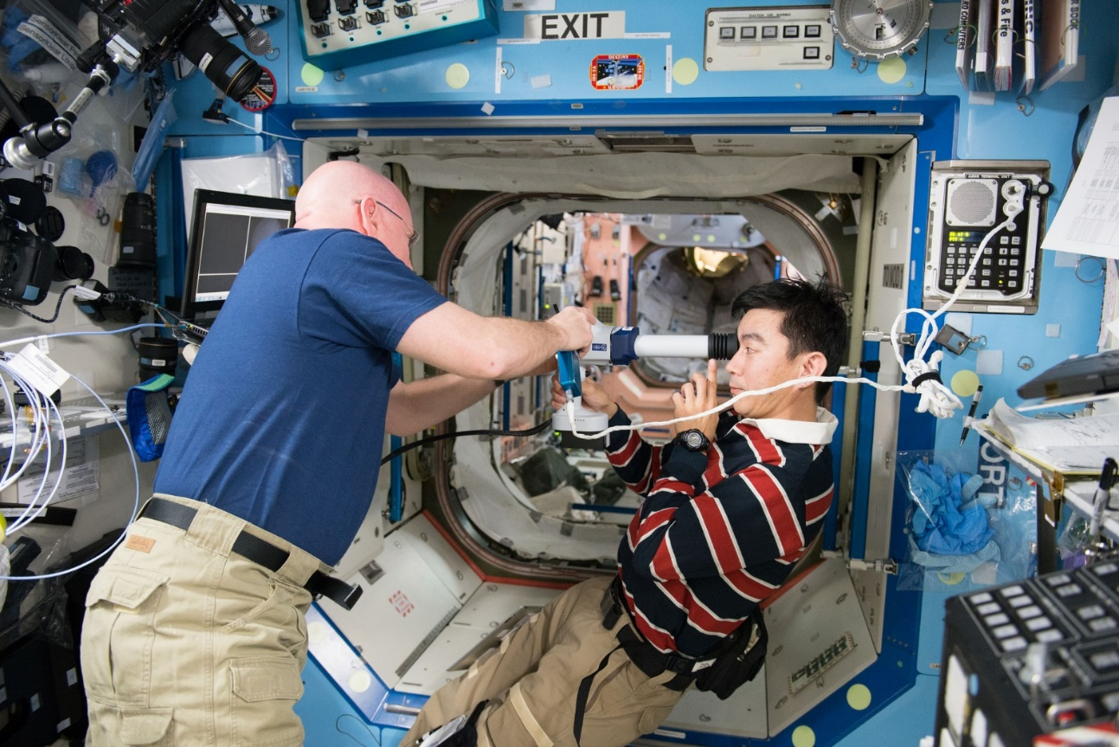
Introduction to Aerospace Medicine
When the human body is exposed to environments outside of our evolved tolerances, it does not always behave as expected
Notes:
https://www.flickr.com/photos/nasa2explore/25212575690/in/album-72157665267866402/

Slide 3
Humans evolved in a specific environment
Constant Gravity of 9.8 m/s²
Atmospheric Pressure near 760 mmHg
With 21% oxygen, 79% nitrogen and some trace gases
Temperature near 24ºC
These are the conditions at sea level on Earth

Slide 4
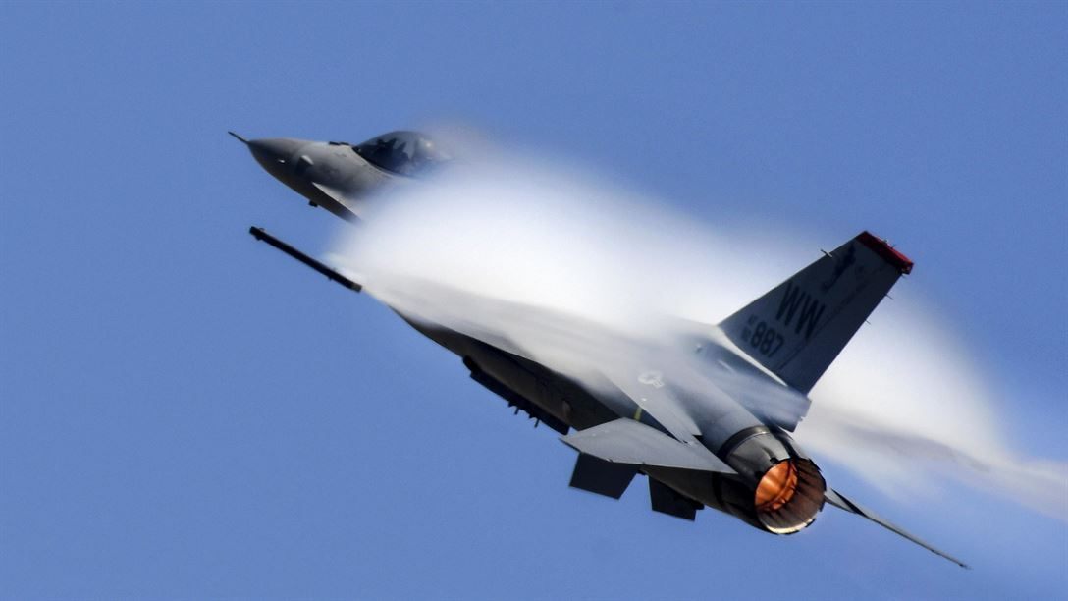
But we did not stay there…
Notes:
https://eca.state.gov/gallery/global-sports-mentoring-program-exchange-alumna-becomes-first-macedonian-woman-climb-mount
https://www.defense.gov/Photos/Photo-Gallery/igphoto/2001708457/
https://www.flickr.com/photos/nasa2explore/9454444948/in/album-72157663341251084/

Slide 5
We have traveled to where the force of gravity cannot be perceived…
Notes:
https://www.flickr.com/photos/nasa2explore/9449183167/in/album-72157663341251084/
Or this one: https://www.flickr.com/photos/nasa2explore/10876418623/in/album-72157665226196132/

Slide 6
… and have experienced when that force is equivalent to over 40 times Earth’s gravity.
Notes:
https://commons.wikimedia.org/wiki/File:Rocket_sled_track.jpg

Slide 7
To where ambient pressure is zero…
Notes:
https://science.nasa.gov/fly-free-space

Slide 8
… and where it is 1,000 times that at sea level.

Slide 9
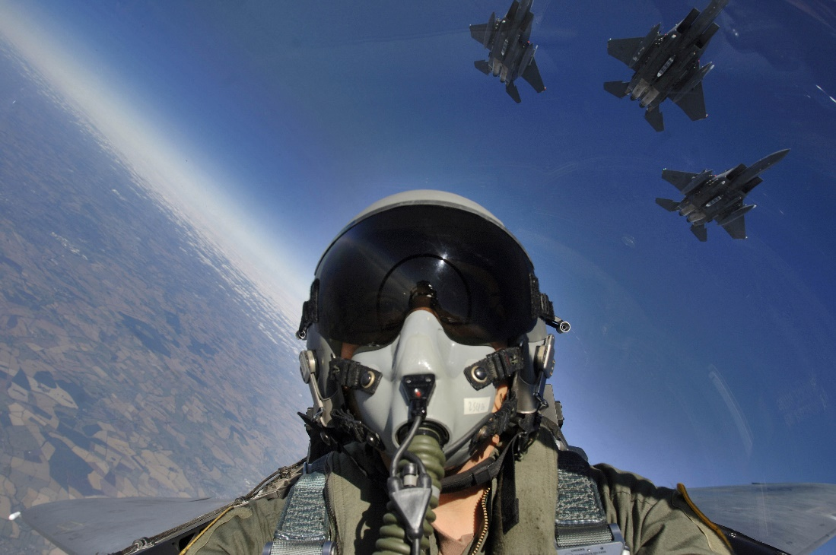
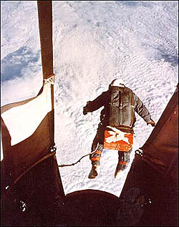
To extreme altitudes where supplemental oxygen & pressure are necessary.
Notes:
http://archive.defense.gov/photos/newsphoto.aspx?newsphotoid=8255
https://www.nps.gov/articles/aviation-pioneers.htm

Slide 10
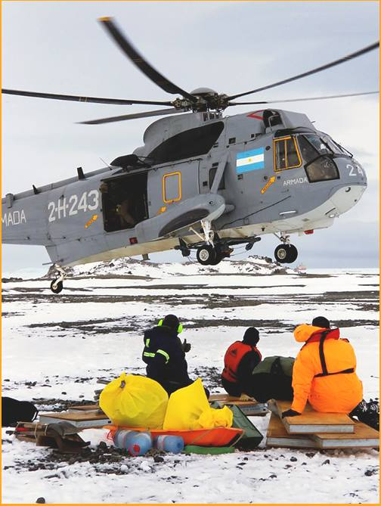
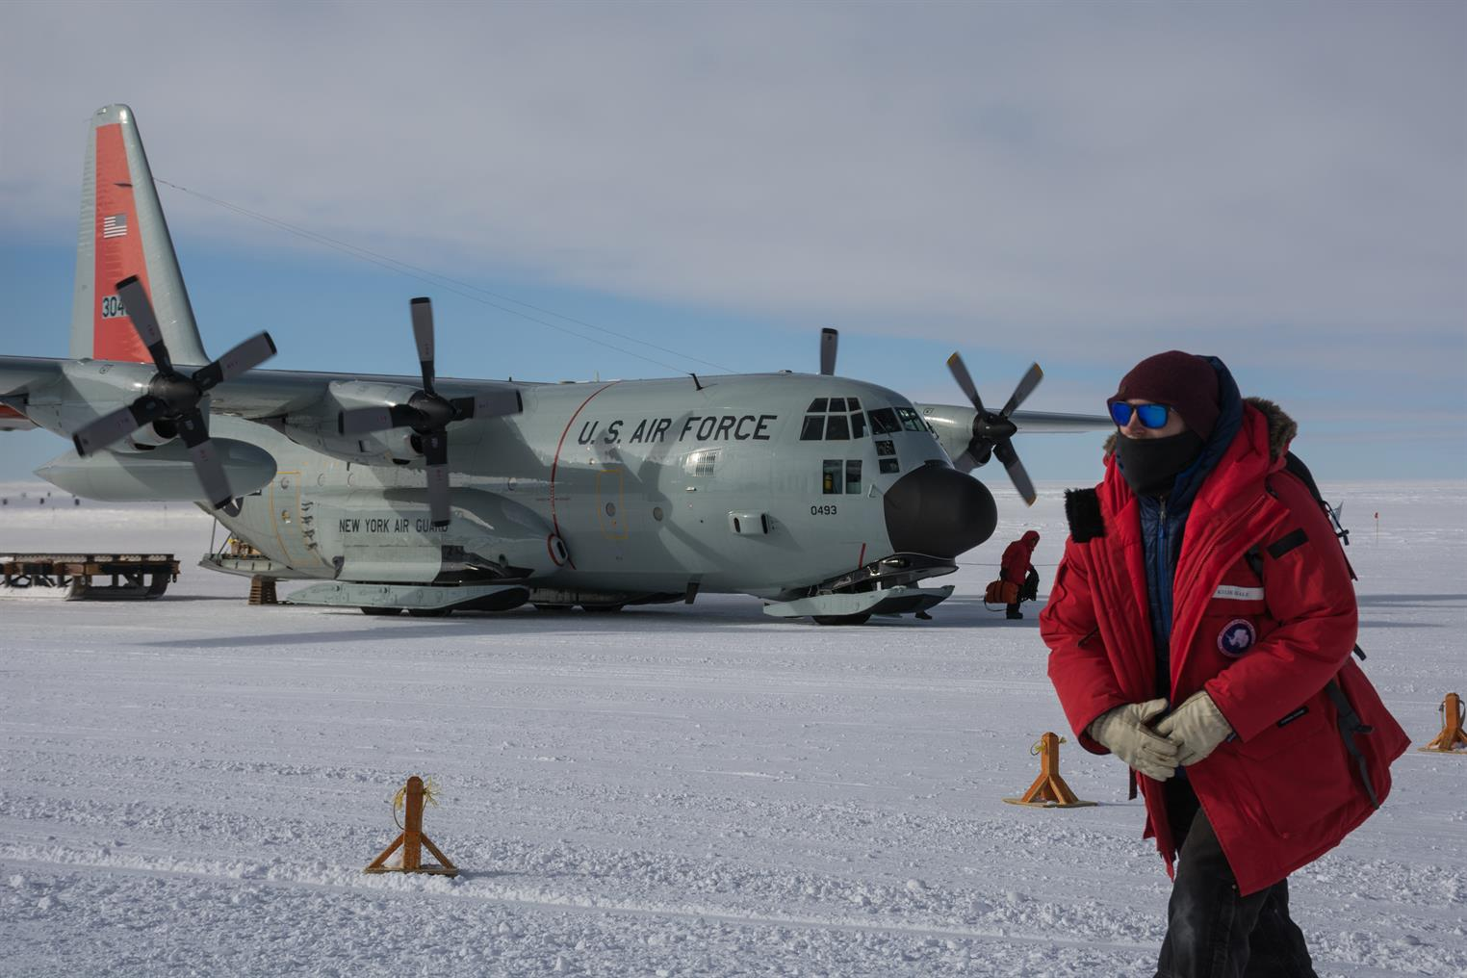
To where temperatures are way below zero…
Notes:
https://photolibrary.usap.gov/#14-1expand2
https://www.facebook.com/1392901317615113/photos/a.1392917884280123.1073741828.1392901317615113/2018924238346148/?type=3&theater

Slide 11
… and where the temperature is hot enough to melt a spacecraft.
Notes:
https://blogs.nasa.gov/orion/category/orion/page/4/

Slide 12
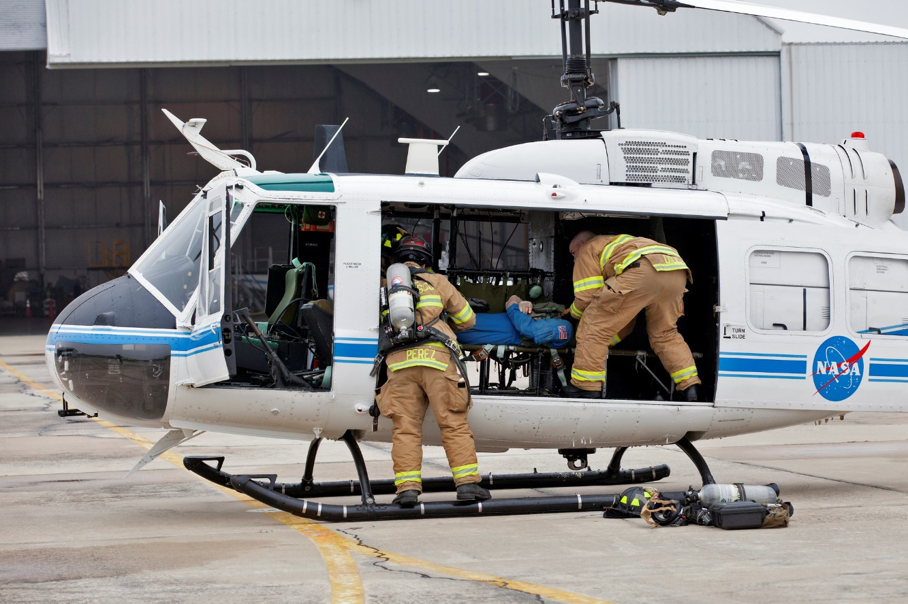
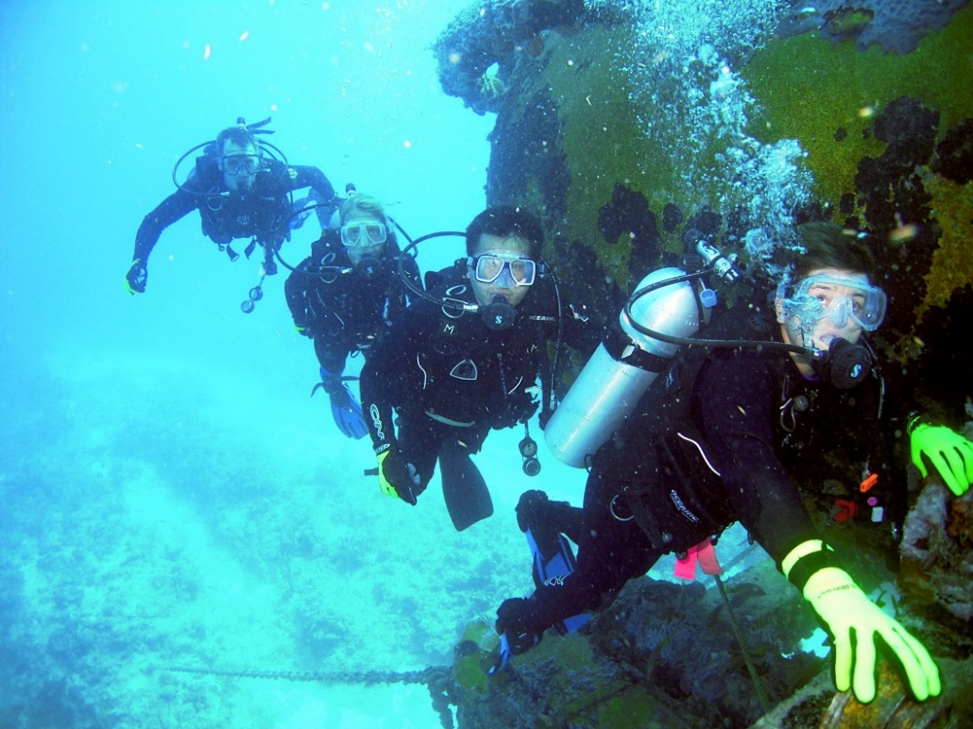
Our practitioners care for people in every corner of the globe…
Notes:
https://www.flickr.com/photos/nasakennedy/40619429702/
https://www.flickr.com/photos/nasa2explore/9368813977/in/album-72157665226196132/

Slide 13
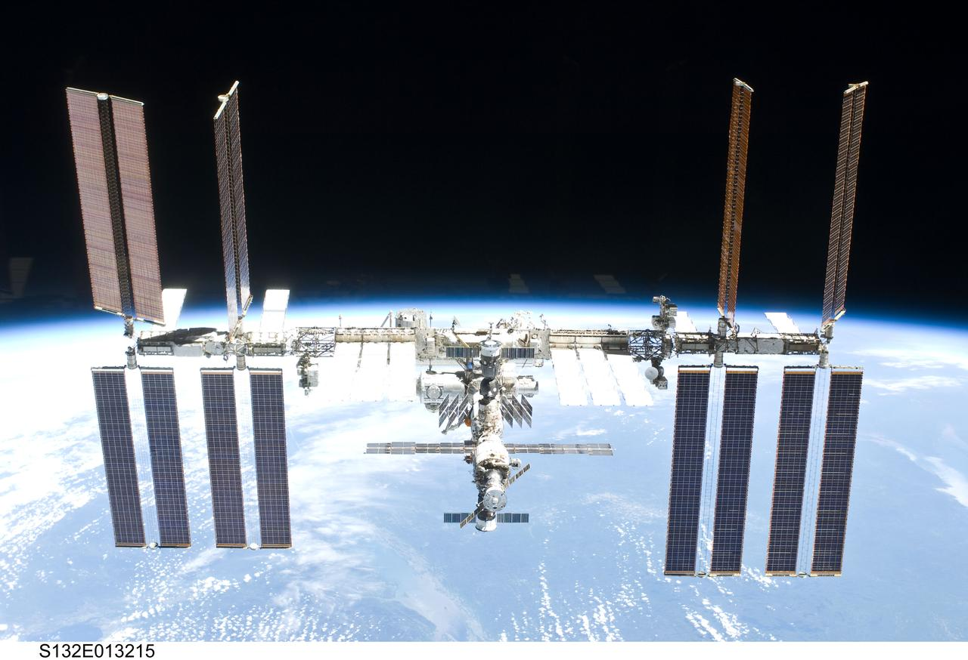
… and beyond it.

Slide 14
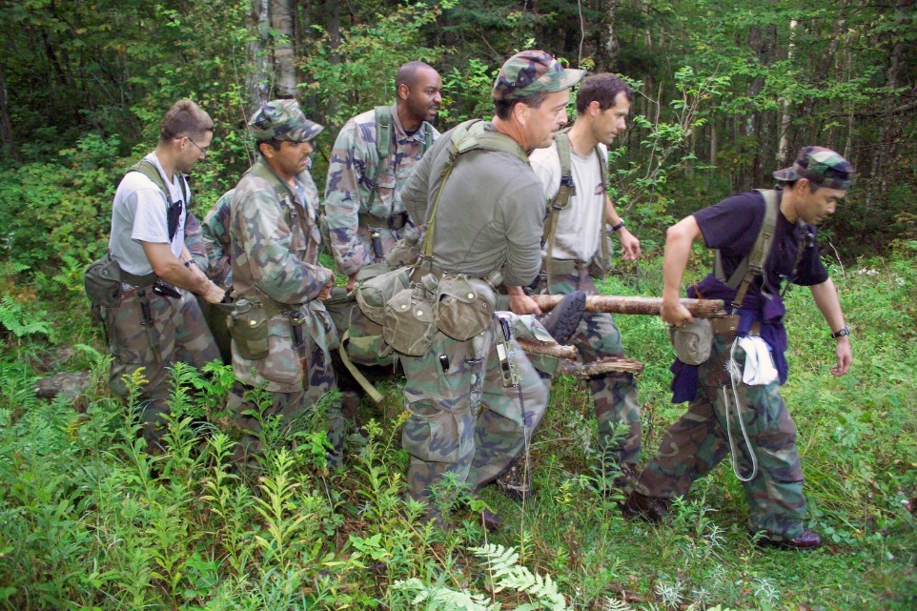
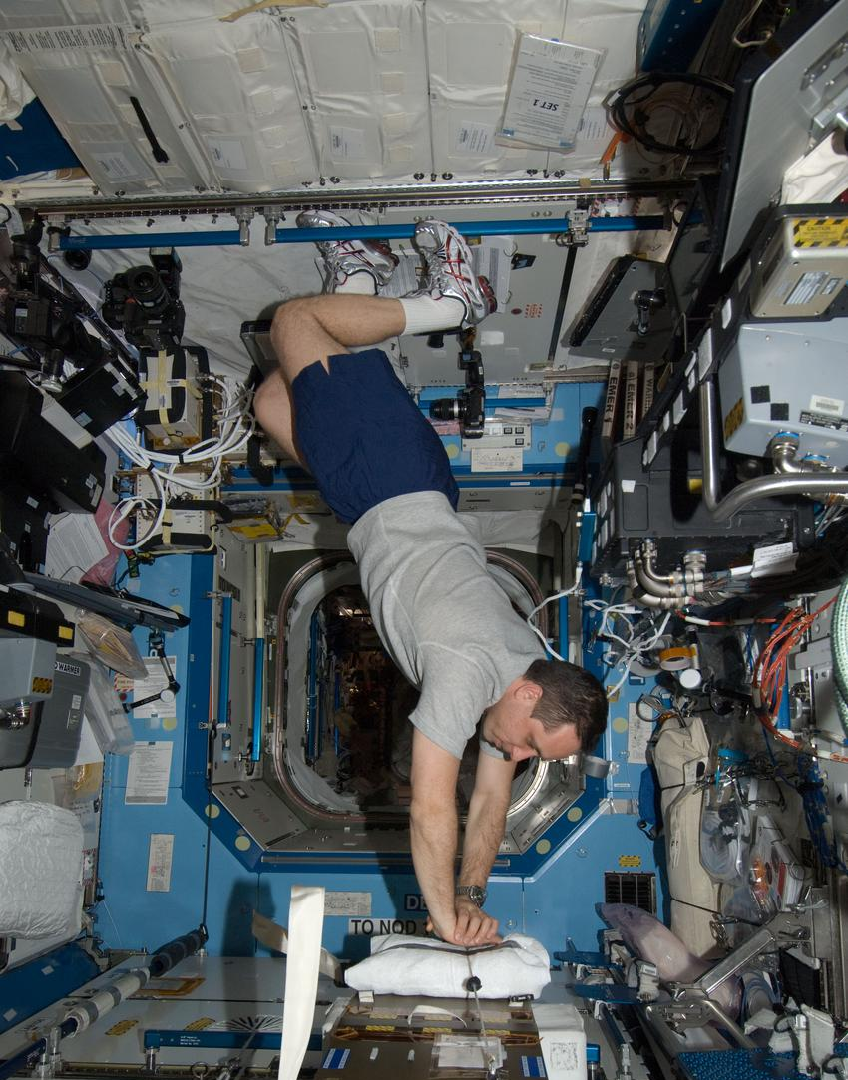
The Practice of Aerospace Medicine
Humans often explore in environments that are dangerous and inhospitable
We have been able to explore every conceivable environment due to our ability to learn, prepare, train, and adapt to that environment
In essence, aerospace medicine is the medicine of extreme environments
Notes:
https://www.flickr.com/photos/nasa2explore/9371193442/in/album-72157662710904974/
https://images.nasa.gov/details-iss030e012600.html

Slide 15
Aerospace Medicine Specialists
Aerospace Medicine specialists draw from the full range of medical specialties
Working with professionals from dozens of other disciplines, Aerospace Medicine Specialists keep people healthy in Earth’s atmosphere and beyond
Aerospace Medicine primarily encompasses four key areas:
Clinical
Research
Education
Policy
Aerospace Medicine Specialists work with:
Engineers
Nurses
Pharmacists
Medics
Doctors
Astronauts
Pilots
Civilians
Military

Slide 16
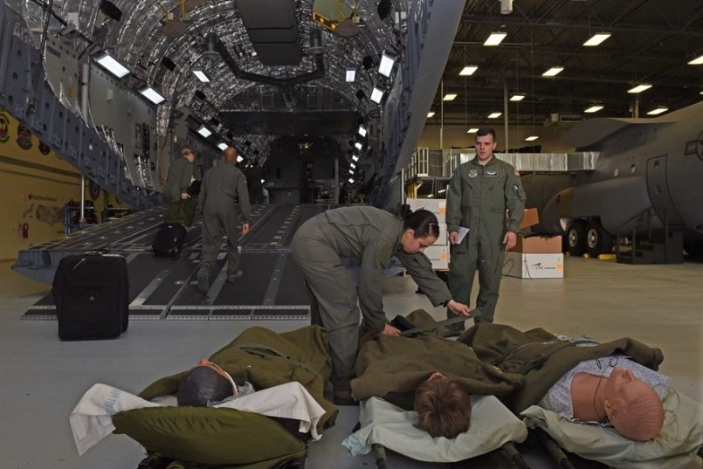
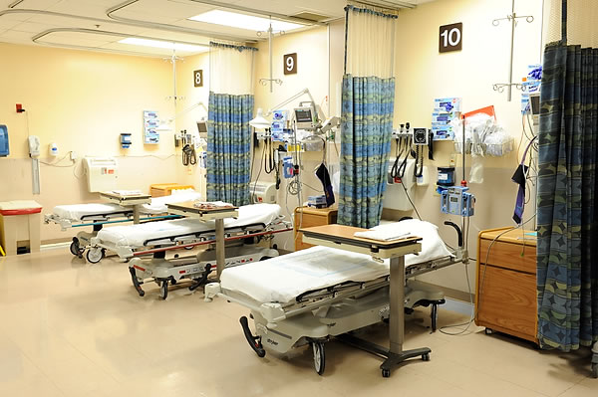
Clinical Aerospace Medicine
Contingency/Emergency Response
Remote Medical Care in the Field
In-Flight Telemedicine
Orbital and Interplanetary Telemedicine
Search and Rescue
Disaster Preparedness
Accident Investigation
Screening and Prevention
Pilots and Air Crew
Astronauts
Air Traffic Controllers
Flight Controllers
Health maintenance
Occupational Health and Wellness
Notes:
http://www.wpafb.af.mil/News/Photos/igphoto/2001862719/
https://www.maryland.va.gov/facilities/baltimore/bt_virtualtour/bt_virtualtour.asp

Slide 17
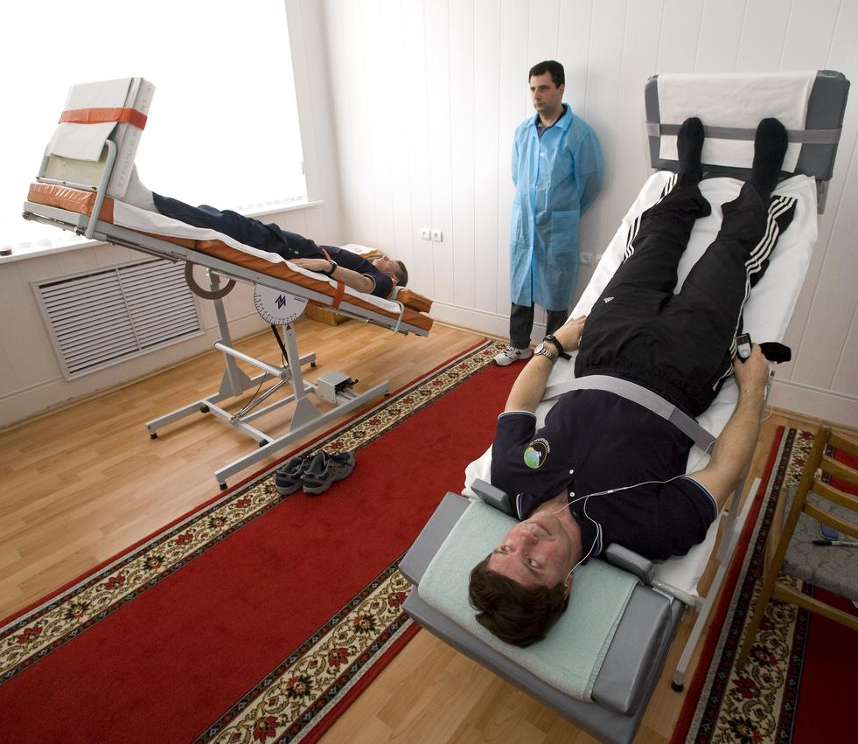
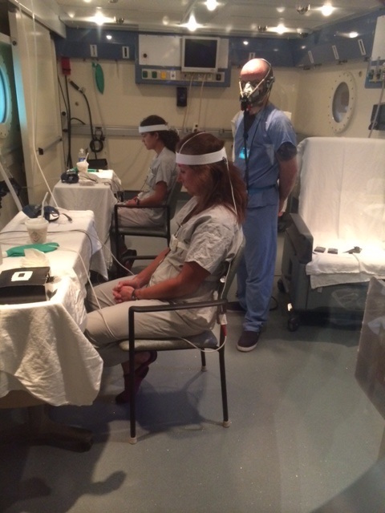
Aerospace Medicine Research
Human Factors:
Habitability
Survivability
User Interfaces
Control Surfaces
Environmental Effects and Mitigation:
High Altitude
Hyperbarics and Hypobarics
Non-standard Gravity
Radiation Countermeasures
Human Physiology:
Sensory Effects of Unusual Environments
Spatial Disorientation
System Specific responses
Behavioral Health and Performance:
Crew Selection
Crew Resource Management
Fatigue Management
Social Isolation
Operations and Contingency Planning
Autonomous Health Systems
Search and Rescue techniques
Life Support Systems
Fitness for Duty Criteria
Notes:
https://images.nasa.gov/details-200903210014HQ.html

Slide 18
Aerospace Medicine Education
Pilots
Military
Civilian
Students
Doctors
General Practitioners
Specialists
Aviation Medical Examiners
Continuing Medical Education
Researchers
Nurses
Clinical practice
Administrators
Researchers
Paramedics
Flight Medics
Critical Care Medics
Public Health Practitioners
Professionals
Engineers
Students
Civilian
Military
Graduate Students
Multiple Disciplines
Other Training:
Aerospace physiology courses
Online courses
University Affiliated Courses
Aerospace Medicine Residencies

Slide 19
Aerospace Medicine Policy
Civil and Military Aviation Health
Defense Health
Transportation Health
Accident Investigation & Prevention
Training Requirements
Government Space Activities
Commercial Space Activities
Behavioral Health Issues:
Addiction
Fatigue
Mental illness
Notes:
https://www.nps.gov/places/us-capitol.htm

Slide 20
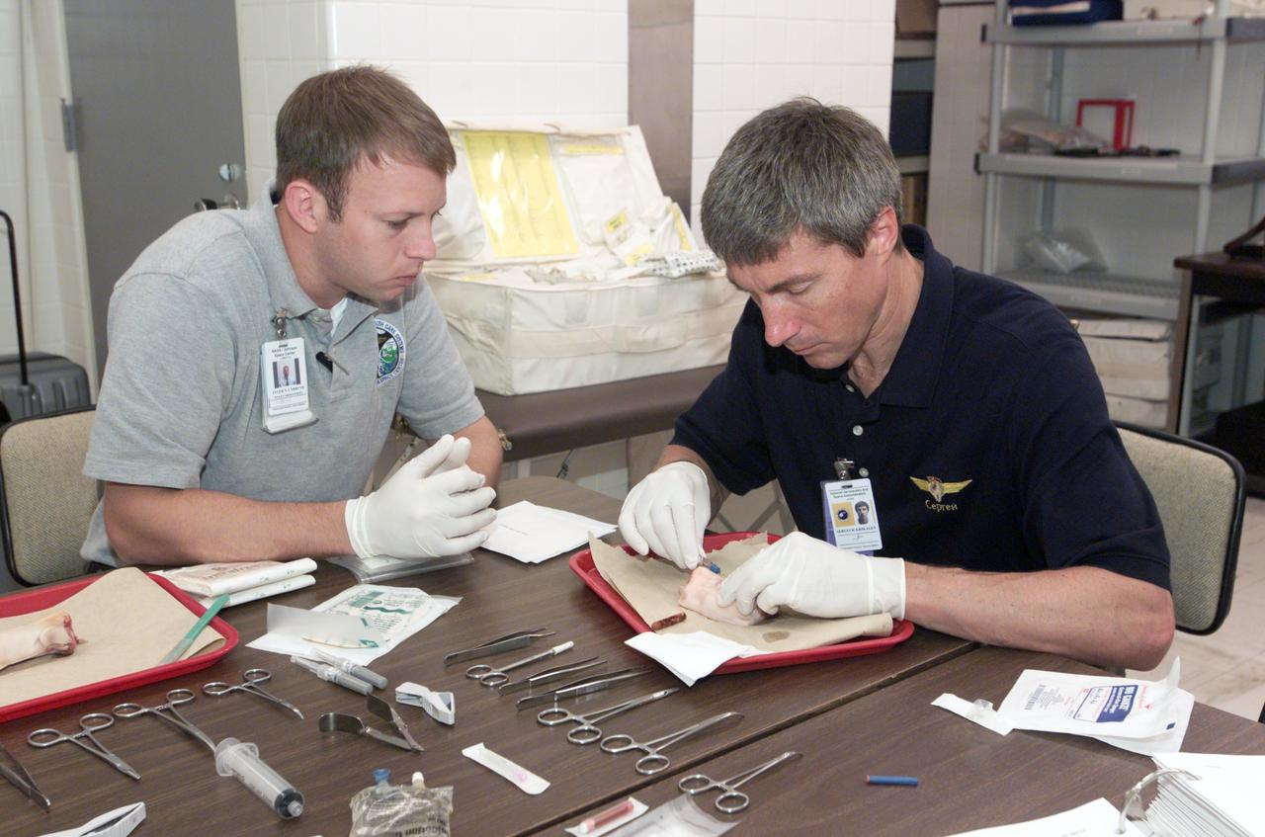
So you want to be an Aerospace Medicine Specialist…
Notes:
https://images.nasa.gov/details-jsc2004e26778.html

Slide 21
Training Path and Opportunities
What it Takes to Become an Aerospace Medicine Specialist
Undergraduate degree
Medical School
Residency training
Subspecialty training
Additional masters or doctorate level training
Aerospace Medicine Residency Programs and Other Education Opportunities

Slide 22
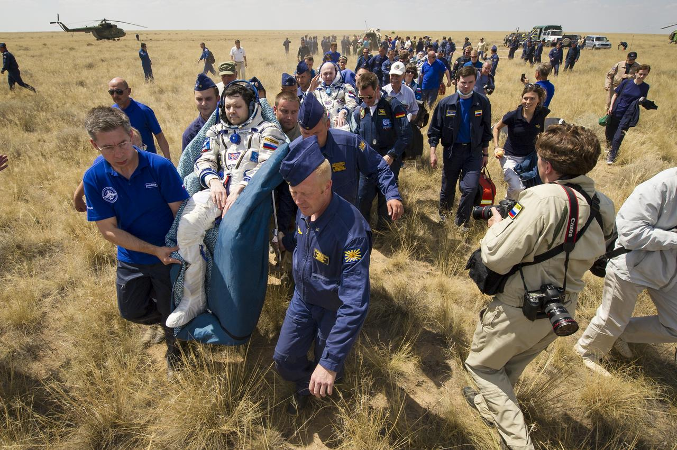
Where Aerospace Medicine Specialists Work
Civilian government
Civil aviation authorities
Civil space flight agencies
Accident investigation boards
Military
Every military and branch that has pilots needs aerospace medicine specialists
Private sector
Commercial aviation
Commercial spaceflight
Travel medicine
Academic medicine
Academic medical centers
Universities
Research organizations
Notes:
https://images.nasa.gov/details-201207010003HQ.html

Slide 23
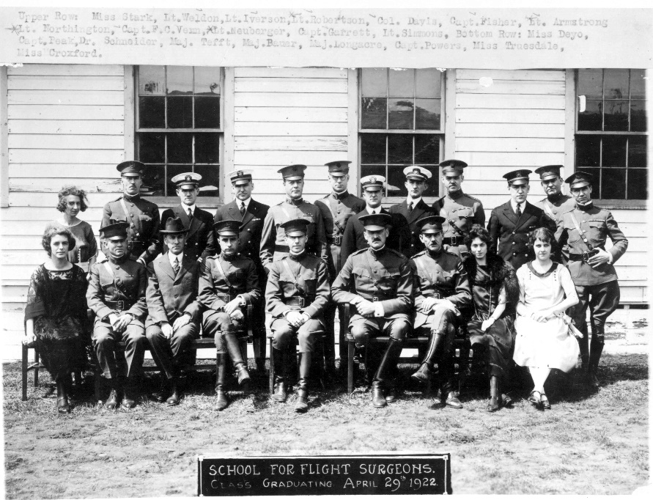
Aerospace Medical Association (AsMA)
International leader in aerospace medicine and human performance
Apply and advance scientific knowledge to promote and enhance the health, safety and performance of those involved in aerospace and related activities
AsMA members are in every country that flies and every country that has a human spaceflight program
https://www.asma.org/
Notes:
https://www.asma.org/asma/media/AsMA/graphics/asma-history_first-fs-class.jpg

Slide 24
This is Aerospace Medicine
Our Calling is to Push the Limits of Human Physiology
Our Task is to Reduce the Risk to Human Wellbeing in Earth’s Atmosphere and Beyond
Our Expertise is in Integrating the Human System into the Technology That Supports Us
Wherever You Imagine We Can Go, Aerospace Medicine Specialists Can Help You Get There

Slide 25
Questions?
Notes:
https://images.nasa.gov/details-KSC-04pd0243.html

